Slide 1
SI 206 Discussion 3:
Dice, the Terminal, and Git

Slide 2
Today
Object oriented programing
Create a dice class and methods to roll the dice, store the value, etc.
Create dice instances, and call the methods
Git : Commit code after each method and push to Github in the end

Slide 3
Disc 4 Assignment
Starter code is on Canvas:
Files ->
Discussions ->
Discussion 3 ->
disc4_starter.py

Slide 4
Problems 1 and 2 (Instructions also in starter code)
Our Dice class will have a constructor (__init__ method) along with additional methods to track our rolls and get data on them. For this exercise, you will be making a Dice class with the following:
Constructor (__init__) method: the constructor will initialize a new dice object that has not yet been rolled. When you create the Dice object you will set how many sides the dice has. By default, it will have 6 sides. In the constructor, initialize instance variables for:
The number of sides
A list keeping track of all of the values this dice has rolled
__str__ method: create a string method so that printing an instance of the dice class outputs the value of the last roll. For example:

Slide 5
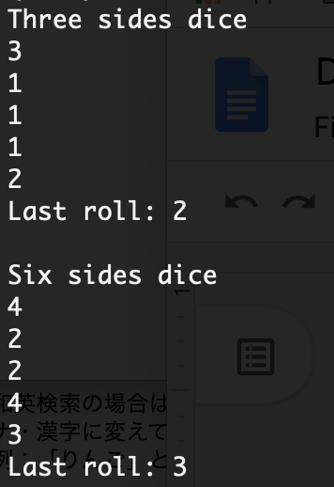
Problems 3 (Instructions also in starter code)
Roll method: Rolls the dice to get a random integer between 1 and the number of sides (hint: use the random module and include both 1 and the number of sides). Save the value at the end of a list that tracks all the values rolled. Returns the number rolled. For example :

Slide 6
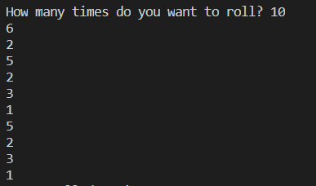
Problems 4 (Instructions also in starter code)
num_rolls method: Takes in user input to quantify the amount of rolls. It asks the users, “How many times do you want to roll?” It the prints out each roll. (hint: use the the input function to handle user input). For example :

Slide 7

Bonus Method (Instructions also in starter code)
print_count_for_num method: Takes in a parameter num which specifies which roll value to look for. Loop through the roll history list and count how many times that num was rolled. Print the number of times that value was rolled, for example :

Slide 8
Git & Github

Slide 9
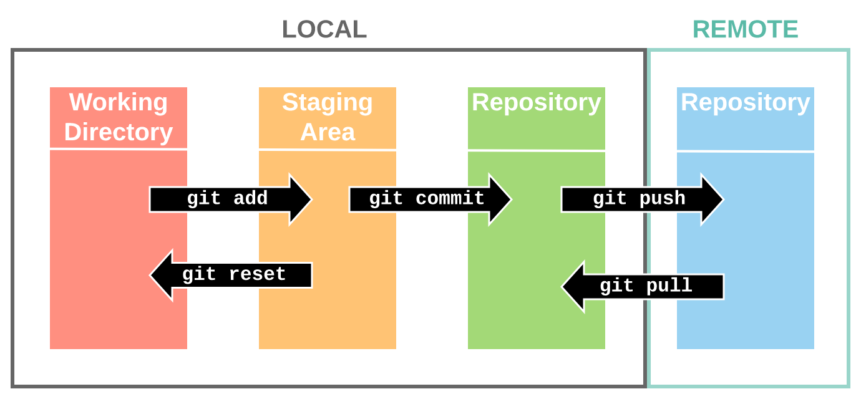

Slide 10
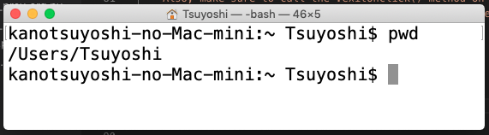
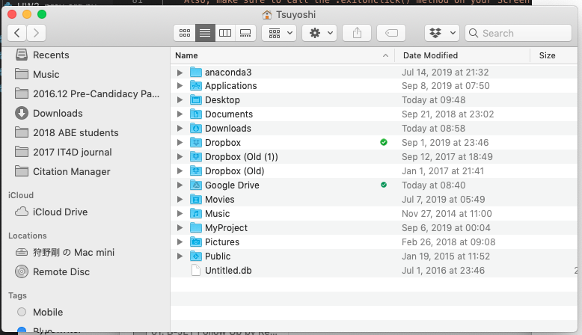
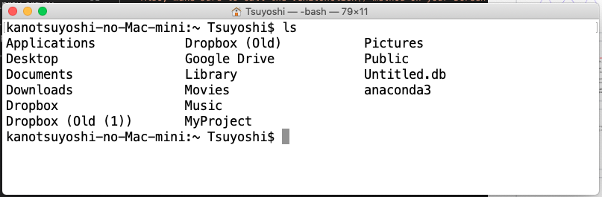
Basic Linux / MS-DOS commands 1
pwd (Mac) / chdir (Win) : Display your location in the file system
ls (Mac) / dir (Win) : Lists files

Slide 11
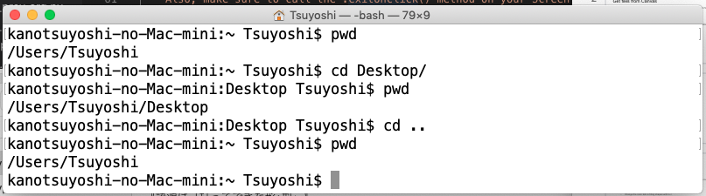
Basic Linux / MS-DOS commands 2
cd pathname: Changes directories
python filename.py / python3 filename.py : Run a python file

Slide 12
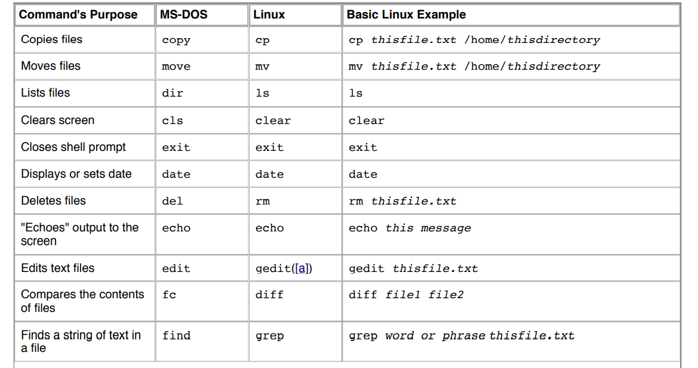

Slide 13
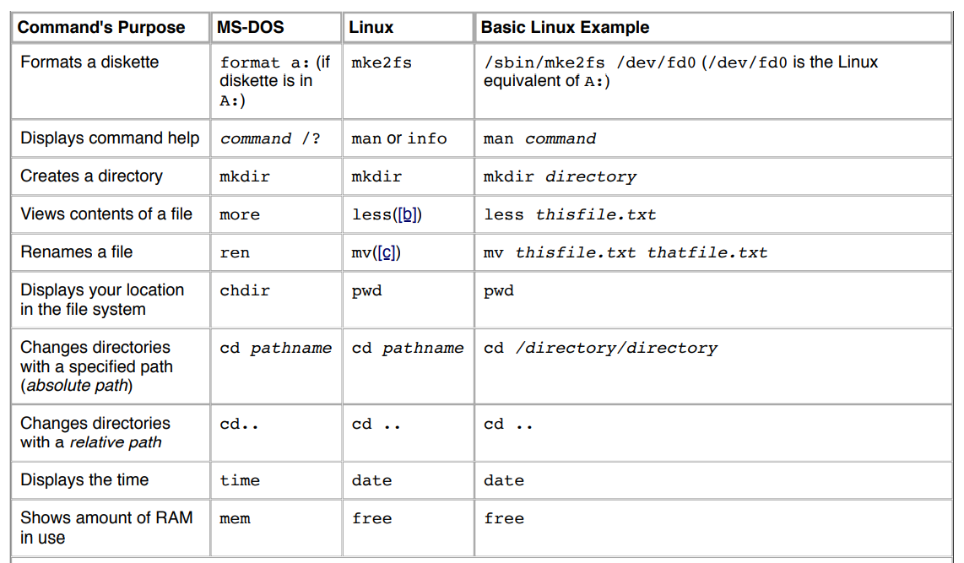

Slide 14
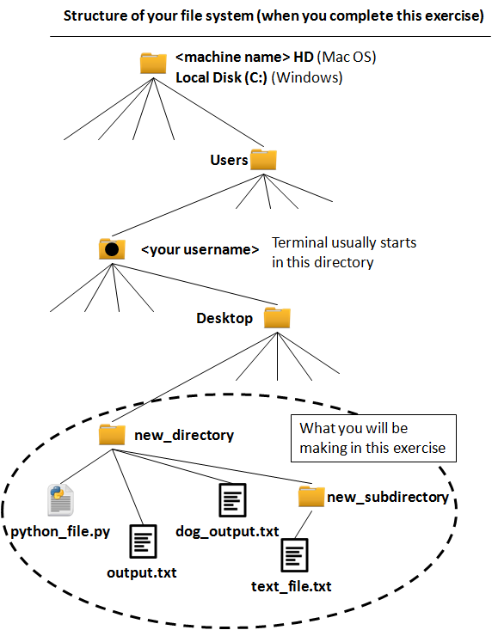
Review: Absolute path and relative path
Absolute path Path from root directory /Users/[Username]/Desktop/new_directory/output.txt Path from home directory ~/Desktop/new_directory/output.txt
Relative path If you are in "new_directory" output.txt If you are in "Desktop" new_directory/output.txt If you are in "new_subdirectory" ../output.txt

Slide 15
What will this do?

Slide 16
What will this do?

Slide 17
What will this do?

Slide 18
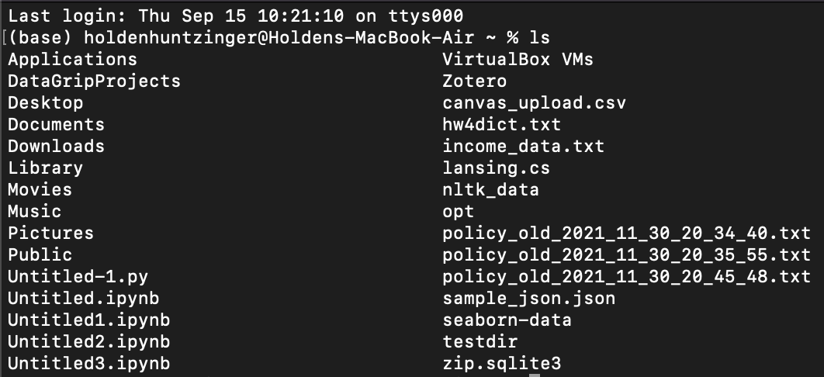
What will this do?

Slide 19
What will this do?

Slide 20
What will this do?

Slide 21
What will this do?

Slide 22
What will this do?

Slide 23
Please ask QUESTIONS

